Slide 1
White-tailed Deer Farms: Weighing the Pros and Cons
Rainn Anderson, Andrew Beck, Alex Emke, Emma Lynch, Nick Moses, Kassidy Vaiknes

Slide 2
Introduction and Background
Game farms are defined as an agricultural property where game animals are raised as livestock typically for the purpose of hunting. They are often used for the sale of antlers, velvet, urine, controlled hunts, meat, and breeding stocks. Whitetail game farms are a controversial concept that goes against the North American Model of wildlife conservation with many negative stigmas yet retaining a historical and economic value that keeps them alive for the “American Sportsman”. This is a highly debated topic due to the blatant overpopulation of the species in the US. Expensive paid hunts of whitetails provides an economic opportunity while at the same time concentrates deer for a heightened risk of spreading CWD and other diseases raging across the states.

Slide 3
Ecological Impacts¹
Rapid spread of disease in game farms
Chronic Wasting Disease (CWD)
Diagnosis and treatment is less reliable than for domesticated livestock
Herbivory and overgrazing
Compaction and erosion of soils
Negative impacts on water quality
Negative impacts on tree and plant species
Alteration of nutrient cycling
Do not provide ecosystem services outside the farm
Lupi, F., & Schulz, M. 2001; Sheppard, M. 2022.

Slide 4
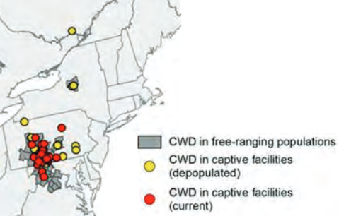
Management Impacts
CWD in Cervid Farms¹
Game Farming in NY²
$200 permit (commercial)
Regulated by USDA and USFWS
Wildlife managers must consider:
Danger to wildlife
Scorched earth policy (CWD)^{1,3}
Cost from management³
¹NYSDEC 2022 ²NYSDEC n.d. ³Sheppard pers. comm. 2022

Slide 5
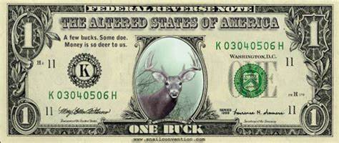
Economic Impacts¹
Major products offered are:
Breeding stock
Meat (venison)
Hunt bucks
Minor products offered are:
Hard antlers and velvet antlers (dietary supplement)
Urine
Hides, tails, leg sinews, and antler buttons
Paid hunting on farms
Stigmatized
Breeder markets
Lupi, F., & Schulz, M. 2001. Farming Captive Cervids in Michigan: A Review of Social, Economic, Ecological and Agricultural Opportunities and Risks. Michigan Agricultural Experiment Station Michigan State University.

Slide 6
Conclusion¹
In conclusion, game farms are heavily debated. They do provide some economic benefits, such as supplying meat and urine. However, game farms lead to detrimental effects both on the deer and their surrounding environment. Not only is the existence of game farms discussed, but they remain a highly contested debate in the face of the North American Model of Wildlife Conservation. Some of the tenets in the North American Model that game farms are in conflict with are: wildlife is a public resource, markets for game are eliminated, wildlife can only be killed for a legitimate purpose, and the democracy of hunting.
As a group, we do not believe that game farms are a good thing. They lead to too many devastating ecological impacts, the most important being the spread of Chronic Wasting Disease inside the facility and outside of its boundaries. For that reason, along with the difficulty of regulating game farms, we believe that the cons outweigh the pros. But what are you views on game farms?
Miller, J. E., and D. A. Miller. 2016. Introduction: Ecological, Biological, Economic, and Social Issues Associated with Captive Cervids. Wildlife Society Bulletin (2011-) 40:7–9.

Slide 7
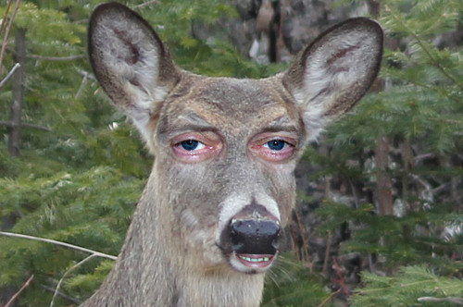
Questions?

Slide 8
Literature Cited
Lupi, F., & Schulz, M. 2001. Farming Captive Cervids in Michigan: A Review of Social, Economic, Ecological and Agricultural
Opportunities and Risks. Michigan Agricultural Experiment Station Michigan State University.
Miller, J. E., and D. A. Miller. 2016. Introduction: Ecological, Biological, Economic, and Social Issues Associated with Captive
Cervids. Wildlife Society Bulletin (2011-) 40:7–9.
NYSDEC. 2022. 2022-2023 New York Hunting & Trapping Guide. First edition. J.F. Griffin Publishing.
NYSDEC. (n.d.). Captive Bred White-tailed Deer License - NYS Dept. of Environmental Conservation.
https://www.dec.ny.gov/permits/25011.html.
Sheppard, M. 2022, December. Personal Interview.

